Slide 1
SPECIAL USE PERMIT CASE NUMBER WSUP20-0006
Truckee Meadows Water Authority, Arrowcreek Booster Pump Station
Washoe County Board of Adjustment
May 7, 2020

Slide 2
Request
Construction and operation of a booster pump station (Utility Services Use Type) to enhance domestic water distribution. The applicant is also asking that the Board vary the paving requirements of all parking and circulation areas.

Slide 3
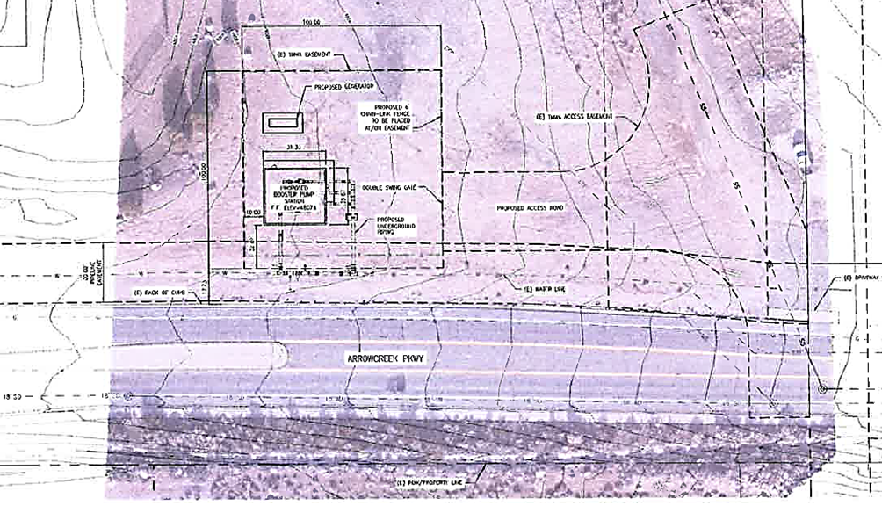
Overview

Slide 4
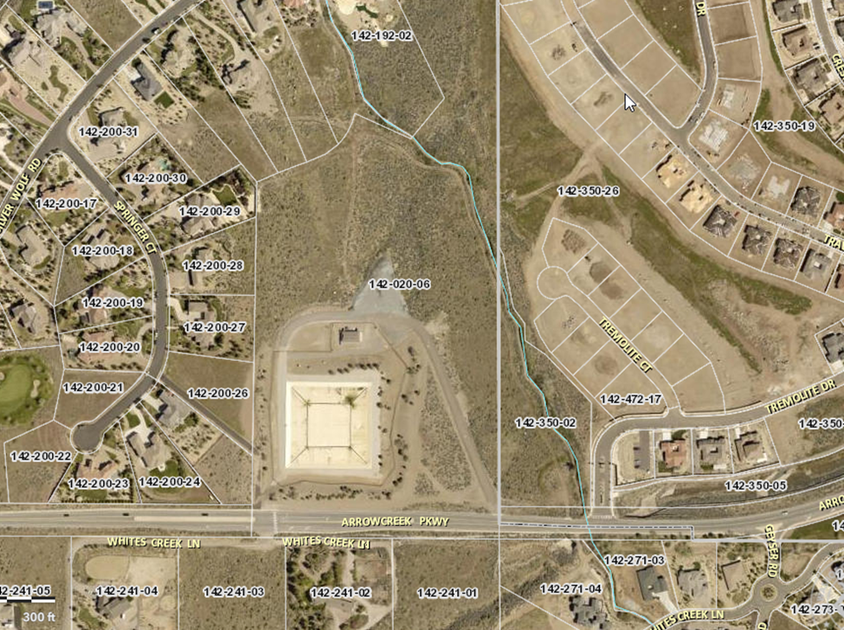
Overview

Slide 5
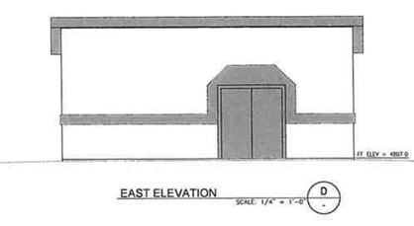
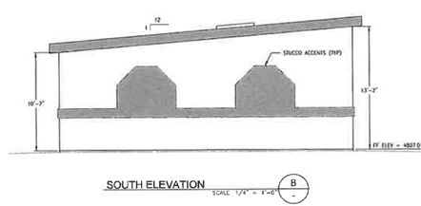
Building Elevations

Slide 6
Conditions
Continue adjacent landscape berm
Coordinate pavement with County Engineering

Slide 7
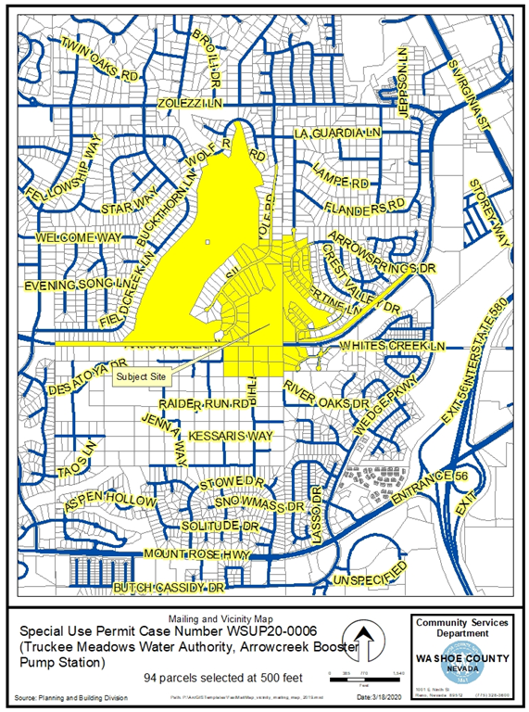
Public Notice & CAB
Notice sent to 94 affected property owners
No CAB meeting during the review for this permit. No individual comments received.

Slide 8
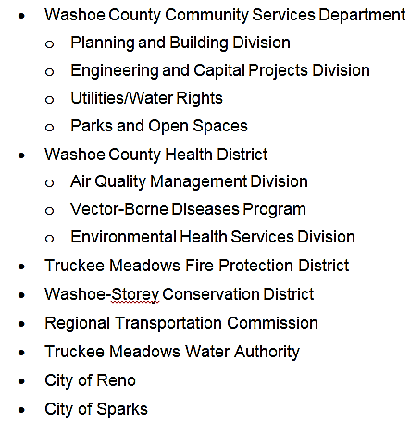
Reviewing Agencies

Slide 9
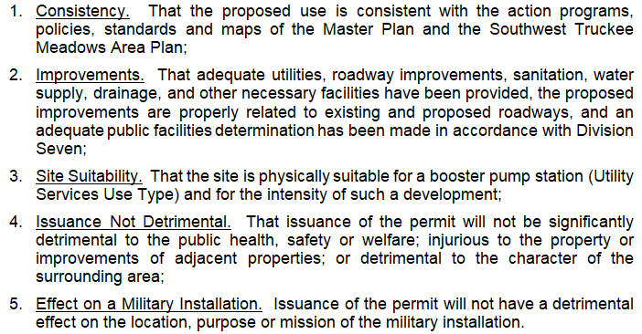
Special Use Permit Findings
(Page 8 of Staff Report)

Slide 10
Recommendation
Approval with conditions, as included at Exhibit A.

Slide 11
Possible Motions
I move that, after giving reasoned consideration to the information contained in the staff report and information received during the public hearing, the Washoe County Board of Adjustment approve, with conditions as included at Exhibit A, Special Use Permit Case Number WSUP20-0006 for Truckee Meadows Water Authority, having made all five findings in accordance with Washoe County Code Section 110.810.30.

